Slide 1
Customer Segmentation Using Data Science by: Julianna Renaud

Slide 2
Project Overview
Utilize past purchase data and historical email engagement data to segment customers into distinct groups.

Slide 3
The Client
A fashion retailer selling a variety of men’s, women’s and children’s clothing and accessories. This client operates both eCommerce and retail business, while also having a large percentage of product sales coming from third party retailers. This project focuses on the client’s eCommerce business.
*For confidentiality purposes, the name of the client will remain anonymous.

Slide 4

The Data
SQL queries were utilized to pull data from the client’s ESP*:
Account Master: Total list of Subscriber IDs
Product File: Product details such as category, sub-category, etc.
Purchase File: Purchase details such as Order ID, Product ID (SKU), Subscriber ID (purchaser)
Subscriber Status: Subscriber’s email program status (Active, Held, Bounced)
Sent Count: The total number of emails sent to the subscriber in the last six months
Open Count: The total number of email opens in the last six months
Click Count: The total number of email clicks in the last six months
No Personally Identifiable Information (PII) was utilized. Subscriber ID was utilized in lieu of email address. City and state data were pulled for location of purchase, but not billing or shipping addresses. No payment data was utilized.

Slide 5
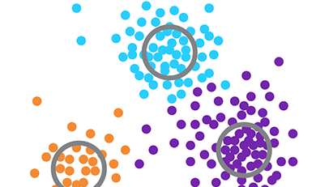
The Methodology
The project was treated as an unsupervised learning classification problem. Sklearn’s Mini Batch KMeans and KMeans algorithms were utilized to build customer clusters. The Elbow Method was utilized to determine the appropriate number of clusters between two and ten.

Slide 6
Data Wrangling
Date Fields: Required proper formatting
Missing Data: The handling of missing data was dependent upon the column
Some columns were dropped
Some columns missing data was replaced with “0”
The Product Quantity column missing data was replaced with “1” (the mean was 1.48, the mode was 1 and the median was 1)
Creation of Categorical Columns: Columns such as Product Category that contained text were pivoted into a column for each category. The columns were then populated with the sum of products purchased in that category for each Subscriber ID.
Pivoting the Data: The data was pivoted to create a single row of data for each SubscriberID
Formulation of Binary Email Columns: Email Status, Email Open Rate, and Email Click Rate were turned into binary columns
More detailed explanations of each data wrangling step can be found in the project Code and Report document.

Slide 7
Data Wrangling
Creation of Calculated Fields: Calculated fields were created to compare behavior from subscriber to subscriber:
Subscriber AOV
Subscriber UPT
% of items purchased by Product Category, Size Category, Product Department and Product Brand
% of orders purchased using a Promo Code (either shipping or product)
Removed Non Purchasers: Since the project is focused on customer segments, removed non customers
Removed Outliers: Based on LTV, removed outliers that were outside of the 95% (two standard deviations from the mean)
Creation of Regional Columns: State data was consolidated into regional columns
More detailed explanations of each data wrangling step can be found in the project Code and Report document.

Slide 8

EDA Overview
Classified purchasers/non purchasers: Subsequently removed non purchasers from dataset
Identified Outliers: Utilized lifetime value (LTV) to determine if any outliers existed in the dataset
Removed Outliers: Removed subscribers with LTV greater than two standard deviations from the mean
Analyzed KPIs:
LTV
Recency
Frequency
AOV
UPT
Identify the benchmark for prediction (the percentage of days that the client currently achieves goal without)
Analyzed data to identify trends
Identified and subsequently removed outliers
Explored the impact of marketing events on revenue

Slide 9
EDA Overview
Email Status: 1/0 binary column for active status (1) or not (0) in ESP
Email Engagement: 1/0 binary columns indicating if they’d opened or clicked at least one email in the last six months
Analyzed Specific Product Data:
Product Size Category Purchased From
Product Department
Product Category
Product Brand
Analyzed Order Location Data (by State of Purchase)
Identify the benchmark for prediction (the percentage of days that the client currently achieves goal without)
Analyzed data to identify trends
Identified and subsequently removed outliers
Explored the impact of marketing events on revenue

Slide 10
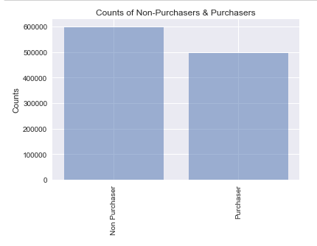
EDA: Non Purchasers/Purchasers
54.64% of Subscriber IDs have not made a purchase
45.36% of Subscriber IDs have made at least one purchase
Non purchasers were removed for the final dataset utilized for clustering.

Slide 11
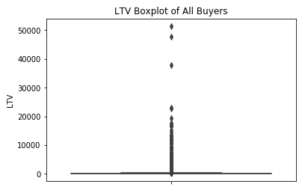
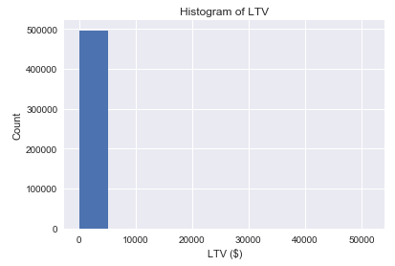
EDA: Lifetime Value (LTV)
Buyer Data Analysis (LTV) All Data
Count | 496,535
Mean | $127.99
Standard Deviation | $230.49
Min | $0.97
25% | $44.97
50% | $78.98
75% | $143.84
Max | $51,496.07

Slide 12
EDA: Overview of Clustering Dataset
Removal of Non purchasers
Removal of Outliers: Rejected Subscriber IDs with LTV outside of two standard deviations from the mean
All subsequent slides and data are representative of the new dataset created after removal of the outliers
Metric | Totals/Averages
Total Buyers (Subscriber IDs) | 471,377
Total Orders | 772,062
Total Revenue | $52,242,809.05
Avg. Recency (days) | 853
Avg. Frequency | 1.64
Avg. LTV | $110.83
AOV | $67.67
Total Products | 1,771,703
Avg. UPT | 2.29
Avg. % of Orders Promo Used | 30.26%

Slide 13
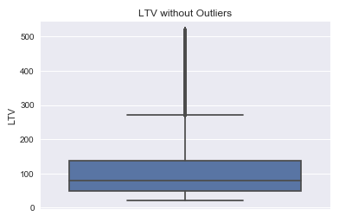
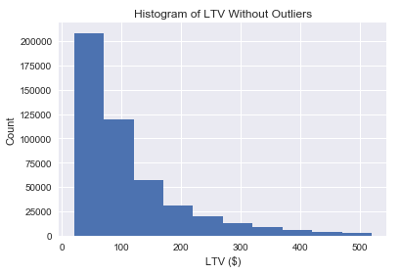
EDA: Revised Lifetime Value (LTV)
Buyer Data Analysis (LTV) Outliers Removed at 95%
Count | 471,377
Mean | $110.83
Standard Deviation | $91.73
Min | $19.98
25% | $47.94
50% | $79.00
75% | $136.96
Max | $519.64

Slide 14
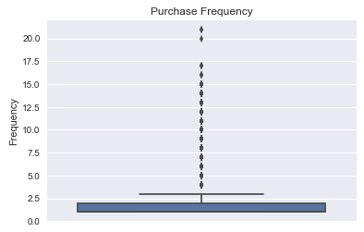
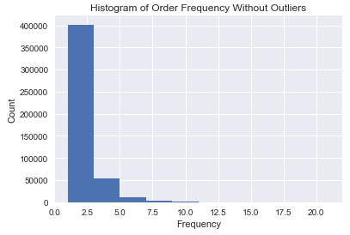
EDA: Frequency
Buyer Data Analysis (Frequency) Outliers Removed at 95%
Count | 471,377
Mean | 1.63
Standard Deviation | 1.14
Min | 1.00
25% | 1.00
50% | 1.00
75% | 2.00
Max | 21.00

Slide 15
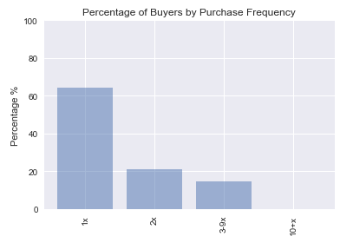
EDA: Frequency
Breakdown by Frequency:
61.16%: 1 x Buyer
21.03%: 2 x Buyer
14.72%: 3 – 9 x Buyer
0.09%: 10+ x Buyer

Slide 16
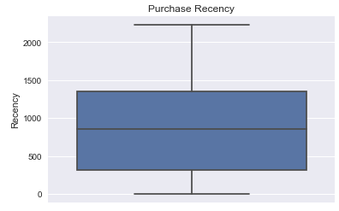
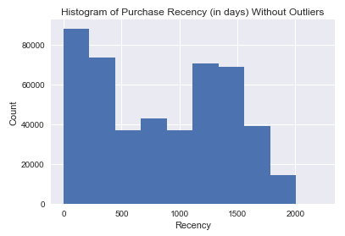
EDA: Recency
Buyer Data Analysis (Recency in Days) Outliers Removed at 95%
Count | 471,377
Mean | 853
Standard Deviation | 562
Min | 0
25% | 317
50% | 851
75% | 1,355
Max | 2,227

Slide 17
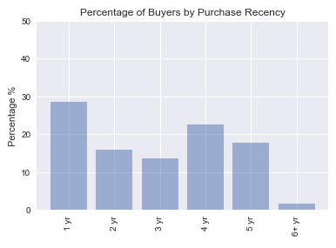
EDA: Recency
Breakdown by Recency:
28.47%: 1 year
15.95%: 2 year
13.71%: 3 year
22.62%: 4 year
17.70%: 5 year
1.56%: 6+ year

Slide 18
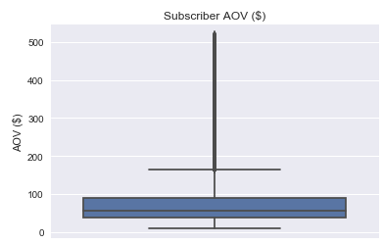
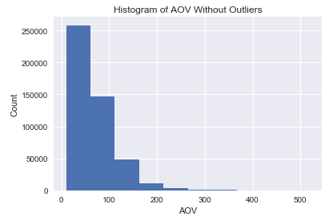
EDA: AOV
Buyer Data Analysis (Recency in Days) Outliers Removed at 95%
Count | 471,377
Mean | $69.96
Standard Deviation | $44.29
Min | $9.99
25% | $39.16
50% | $56.91
75% | $89.00
Max | $519.54

Slide 19
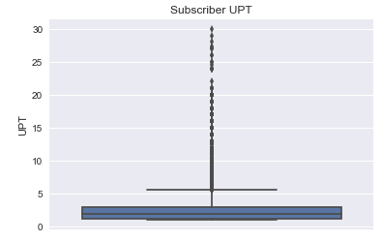
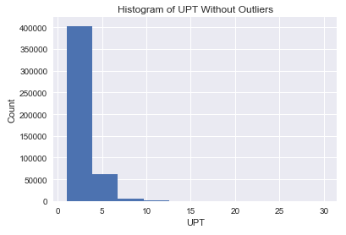
EDA: UPT
Buyer Data Analysis (Recency in Days) Outliers Removed at 95%
Count | 471,377
Mean | 2.34
Standard Deviation | 1.39
Min | 1.00
25% | 1.25
50% | 2.00
75% | 3.00
Max | 30.00

Slide 20
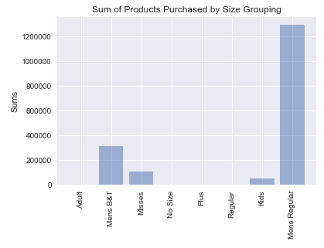
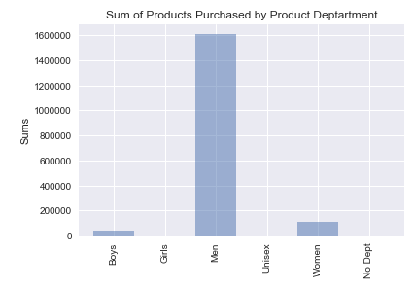
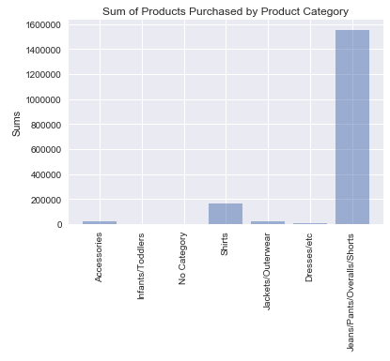
EDA: Product Data
72.82% of products purchased were from the Men’s Regular Size Group
90.80% of products purchased were from the Men’s Product Department
87.76% of products purchased were from the Jeans/Pants/Overalls/Shorts Category

Slide 21
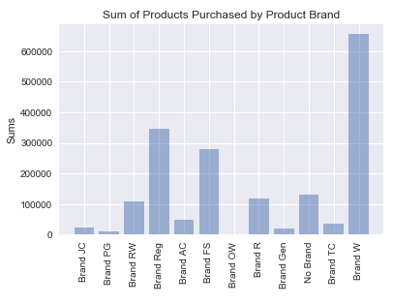
EDA: Product Data
37.03% of products purchased were from the W Brand group.
19.52% of products purchased were from the Reg Brand group.
15.72% of products purchased were from the FS Brand group.

Slide 22
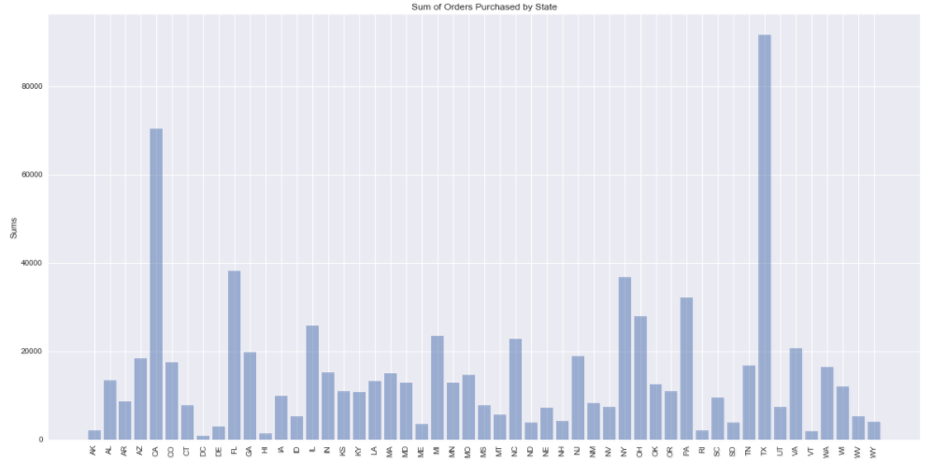
EDA: Order Location Data
11.87% of orders came from Texas.
9.12% of orders came from California.

Slide 23
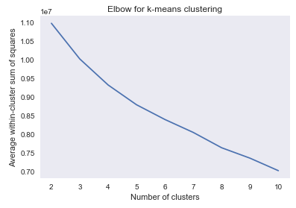
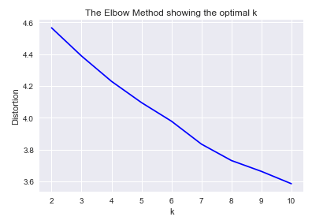
Clustering
The Elbow Method for Determining the Appropriate number of clusters.
As K increases, the centroids become closer to the cluster centroids and the improvements will begin to decline, in theory creating an elbow shape.
Top Graph: Avg. Within Cluster Sum of Squares
Bottom Graph: Distortion
Number of Clusters Selected = 8

Slide 24
Persona: Engaged Email & Promotional
(Cluster 0)
Number of Subscribers: 42,185 (8.95% of total buyers)
Most recent purchasers of any cluster; on average their most recent purchase date was 369 days ago
Most promotionally influenced of any cluster; average promotional offer use by this cluster was 49.84% of orders utilized a promo
Most engaged with email, nearly 100% have opened and clicked at least one email in the last 6 months
80% of products purchased were Men’s Regular Size
99% of products purchased were from the Men’s Product Department
95% of products purchased were Jeans/Pants/Overalls /Shorts
Recency
Average: 369 Days Ago
Frequency
Average: 1.69 Purchases
LTV
Average: $97.95

Slide 25
Persona: (Cluster 1)
Number of Subscribers: 61,480 (13.04% of total buyers)
Second longest recency of any cluster, on average they made their most recent purchase 974 days ago (between 2 and 3 years ago)
93% of products purchased were from “Other Brands”; this Brand category was the summation of products purchased in either Brand JC, Brand PG, Brand RW, Brand AC, Brand OW, Brand R, Brand Gen or Brand TC
70% of products purchased were Men’s Regular Size
100% of products purchased were from the Men’s Product Department
98% of products purchased were Jeans/Pants/Overalls /Shorts
Recency
Average: 974 Days Ago
Frequency
Average: 1.35 Purchases
LTV
Average: $86.55

Slide 26
Persona: Unengaged & Lapsed
(Cluster 2)
Number of Subscribers: 101,548 (21.54% of total buyers)
Least recent purchasers of any cluster, on average their most recent purchase date was 1,048 days ago
The largest cluster with 101,548 subscriber IDs
Least engaged with email, only 10% have opened an and email in the last 6 months and less than 1% have clicked
89% of products purchased were Men’s Regular Size
99% of products purchased were from the Men’s Product Department
98% of products purchased were Jeans/Pants/Overalls /Shorts
Recency
Average: 1,048 Days Ago
Frequency
Average: 1.31 Purchases
LTV
Average: $100.94

Slide 27
Persona: Frequent Buyer & Big Spender
(Cluster 3)
Number of Subscribers: 47,331 (10.04% of total buyers)
The highest frequency of any cluster, on average they’ve made 3.83 purchases in their lifetime
The highest AOV of any cluster, on average a subscriber in this cluster spends $102.51 per order
The highest UPT of any cluster, on average they purchase 3.43 products/order
The least promotionally influenced; average promotional offer use by this cluster of 24.51% was the lowest of any cluster
Purchasing Men’s products, but not necessarily the Regular Size
75% of products purchased were Men’s Regular Size
96% of products purchased were from the Men’s Product Department
89% of products purchased were Jeans/Pants/Overalls /Shorts
Recency
Average: 524 Days Ago
Frequency
Average: 3.83 Purchases
LTV
Average: $313.69

Slide 28
Persona: Low Spenders
(Cluster 4)
Number of Subscribers: 78,145 (16.58% of total buyers)
The lowest LTV of any cluster, on average they’ve spent $69.95 in their lifetime
76% of products purchased were from Brand Reg
18% of products purchased were unbranded products (those that did not contain brand details in the product file); this was the highest of any cluster
84% of products purchased were Men’s Regular Size
100% of products purchased were from the Men’s Product Department
98% of products purchased were Jeans/Pants/Overalls /Shorts
Recency
Average: 880 Days Ago
Frequency
Average: 1.38 Purchases
LTV
Average: $69.95

Slide 29
Persona: Not Buying Men’s
(Cluster 5)
Number of Subscribers: 48,201 (10.23% of total buyers)
These shoppers ARE NOT purchasing Men’s Products
82% of products purchased were from Brand W
1.50% of products purchased were Men’s Regular Size
2.09% of products purchased were from the Men’s Product Department
82% of products purchased were Jeans/Pants/Overalls /Shorts
Recency
Average: 885 Days Ago
Frequency
Average: 1.40 Purchases
LTV
Average: $104.40

Slide 30
Persona: Brand FS Buyers
(Cluster 6)
Number of Subscribers: 50,506 (10.71% of total buyers)
The lowest LTV of any cluster, on average they’ve spent $69.95 in their lifetime
The lowest AOV of any cluster, on average a subscriber in this cluster spends $51.01 per order, but
The second highest UPT of any cluster, on average they purchase 2.56 products/order
89% of products purchased by this group are from the Brand FS
80% of products purchased were Men’s Regular Size
99% of products purchased were from the Men’s Product Department
98% of products purchased were Jeans/Pants/Overalls /Shorts
Recency
Average: 880 Days Ago
Frequency
Average: 1.48 Purchases
LTV
Average: $71.61

Slide 31
Persona: Not Jean Shoppers
(Cluster 7)
Number of Subscribers: 41,981 (8.91% of total buyers)
The smallest of all of the clusters with 41,981 subscribers (although close in size to cluster 0)
Purchasing Men’s products, but NOT from the Jeans/Pants/Overalls/Shorts categories.
They are the only segment not likely to purchase jeans/pants/ overalls/shorts; 94% of the products purchased from this segment are from categories other than jeans etc
The lowest frequency of any cluster, on average a subscriber in this cluster has purchased 1.28 times in their lifetime with the brand
68% of products purchased were Men’s Regular Size
98% of products purchased were from the Men’s Product Department
6% of products purchased were Jeans/Pants/Overalls /Shorts
Recency
Average: 944 Days Ago
Frequency
Average: 1.28 Purchases
LTV
Average: $85.22

Slide 32

Next Steps
What are the next steps?

Slide 33
Client Recommendations

Slide 34
Average Purchase Behavior by Cluster
Cluster # | # of Subscribers | Recency (days) | Frequency | Monetary Value (LTV) | Products Purchased Lifetime | Subscriber AOV | Subscriber UPT | % of Orders Promo Utilized
0 | 42,185 | 369 | 1.65 | $97.95 | 3.6 | $62.71 | 2.29 | 49.84%
1 | 61,480 | 974 | 1.35 | $86.55 | 2.8 | $67.17 | 2.15 | 28.62%
2 | 101,548 | 1,048 | 1.31 | $100.94 | 2.6 | $80.22 | 2.06 | 25.57%
3 | 47,331 | 524 | 3.83 | $313.69 | 10.8 | $102.51 | 3.43 | 24.51%
4 | 78,145 | 880 | 1.38 | $69.95 | 3.1 | $52.51 | 2.35 | 27.59%
5 | 48,201 | 885 | 1.40 | $104.40 | 2.8 | $75.44 | 2.01 | 30.53%
6 | 50,506 | 880 | 1.48 | $71.61 | 3.5 | $51.01 | 2.56 | 33.96%
7 | 41,981 | 944 | 1.28 | $85.22 | 2.7 | $68.85 | 2.17 | 31.07%

Slide 35
Average Product Behavior by Cluster
(Average Percentages of Products Purchased by Size Category (Men’s Reg vs. Not Men’s Reg), Product Department
(PD Men vs. PD Not Men) & Category (Jeans/Pants/Overalls/Shorts vs. Other))
Cluster # | # of Subscribers | Men’s Reg | Not Men’s Reg | PD Men | PD Not Men | Category Jeans etc. | Category Other
0 | 42,185 | 79.93% | 20.07% | 98.77% | 1.23% | 95.01% | 4.99%
1 | 61,480 | 69.57% | 30.43% | 99.60% | 0.40% | 98.21% | 1.79%
2 | 101,548 | 88.96% | 11.04% | 99.26% | 0.74% | 97.82% | 2.18%
3 | 47,331 | 74.82% | 25.18% | 95.88% | 4.12% | 89.01% | 10.99%
4 | 78,145 | 83.97% | 16.03% | 99.70% | 0.30% | 98.49% | 1.51%
5 | 48,201 | 1.50% | 98.50% | 2.09% | 97.91% | 82.47% | 17.53%
6 | 50,506 | 79.67% | 20.33% | 99.45% | 0.55% | 98.07% | 1.93%
7 | 41,981 | 68.08% | 31.92% | 98.44% | 1.56% | 6.07% | 93.93%

Slide 36
Average Product Behavior by Cluster
(Average Percentages of Products Purchased by Brand)
Cluster # | # of Subscribers | Brand W | Brand Reg | Brand FS | No Brand | Other Brands
0 | 42,185 | 28.90% | 25.52% | 18.07% | 7.16% | 20.35%
1 | 61,480 | 1.81% | 1.81% | 1.62% | 1.45% | 93.24%
2 | 101,548 | 97.09% | 0.47% | 0.54% | 0.60% | 1.30%
3 | 47,331 | 40.74% | 18.24% | 12.58% | 6.23% | 2.22%
4 | 78,145 | 1.51% | 75.65% | 1.47% | 18.10% | 3.27%
5 | 48,201 | 82.46% | 1.54% | 1.64% | 11.86% | 2.50%
6 | 50,506 | 3.24% | 2.86% | 88.73% | 1.21% | 3.96%
7 | 41,981 | 49.47% | 5.19% | 0.72% | 13.25% | 31.37%

Slide 37
Average Email Behavior by Cluster
(Email Open and Email Click Percentages are based on the Number of Subscribers with an Active Status)
Cluster # | # of Subscribers | # of Subscribers with Active Status | % Opened Email in Last 6 Months | % Clicked an Email in Last 6 Months
0 | 42,185 | 41,986 | 98.95% | 100.00%
1 | 61,480 | 59,089 | 12.44% | 0.27%
2 | 101,548 | 97,671 | 9.70% | 0.08%
3 | 47,331 | 46,020 | 25.17% | 11.59%
4 | 78,145 | 74,726 | 13.46% | 0.20%
5 | 48,201 | 46,480 | 24.44% | 13.15%
6 | 50,506 | 48,476 | 13.94% | 0.39%
7 | 41,981 | 40,444 | 20.13% | 9.80%

Slide 38
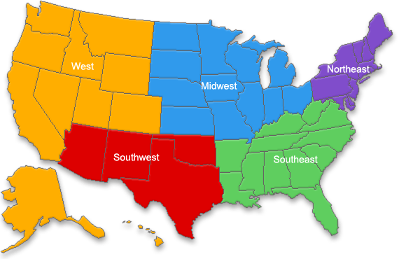
Percent of Orders by Region
Cluster # | Northeast | Southeast | Midwest | Southwest | West
0 | 20.30% | 24.99% | 22.59% | 14.88% | 17.24%
1 | 21.03% | 25.35% | 25.20% | 12.65% | 15.77%
2 | 10.90% | 25.23% | 18.59% | 24.61% | 20.68%
3 | 17.88% | 23.05% | 21.36% | 18.78% | 18.94%
4 | 21.13% | 25.79% | 24.23% | 11.69% | 17.15%
5 | 13.02% | 21.64% | 21.09% | 17.71% | 26.54%
6 | 26.54% | 22.97% | 21.84% | 11.13% | 17.51%
7 | 15.79% | 24.39% | 19.95% | 18.74% | 21.13%
Unclustered | 17.96% | 24.19% | 21.73% | 16.94% | 19.17%

Slide 39



Julianna Renaud
Charlotte Werger, PhD
Web Analytics Strategist
Springboard Mentor

